Slide 1
Selecting the branches for an evolutionary tree.
A polynomial time approximation scheme
Jonathan Badger, Paul Kearney, Ming Li, John Tsang, and Tao Jiang
Journal of Algorithms 51 (2004) 1–14
Presenter: Yung-Hsing Peng
Date: 2005.01.21

Slide 2
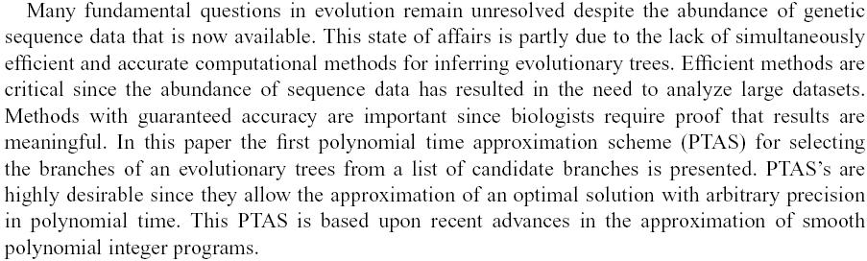
Abstract

Slide 3
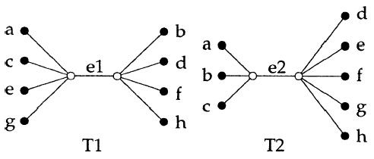
Scoring Method
Let bipartition S = ( {a, b, c, d}, {e, f, g, h} )
For the following two trees T1 and T2, compare them with S
Scoring Method (1): Exact Match → Both T1 and T2 are 0 (used in CC)
Scoring Method (2): Partial Match → T1 is 4 and T2 is 7 (used in FCC)
Both scoring method can be done in polynomial time, but the second method is more flexible
We shall give a more detail example for the second method

Slide 4
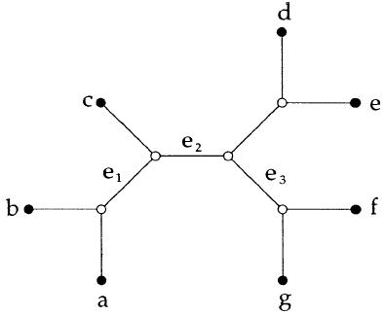

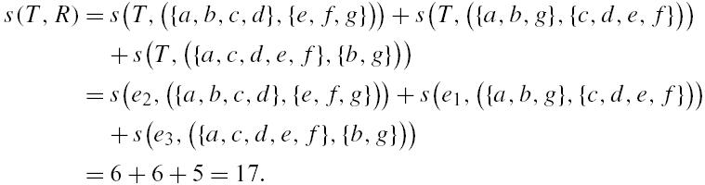
Example for Scoring Method Used in FCC
Tree T
Bipartition Set R = ( {{a, b, c, d}, {e, f, g}},
{{a, b, g}, {c, d, e, f}},
{{a, c, d, e, f}, {b, g}} )
Now it’s time to introduce the definition of CC and FCC (next page)

Slide 5
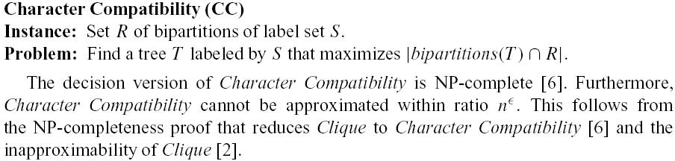

CC Problem and FCC Problem
FCC is also NP-complete, but it can be approximated, which is proved in this paper.

Slide 6
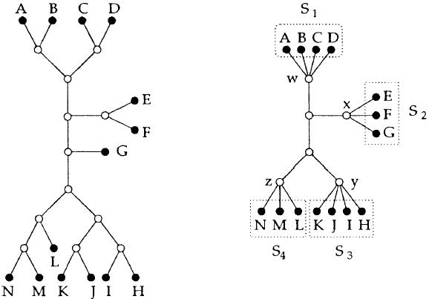
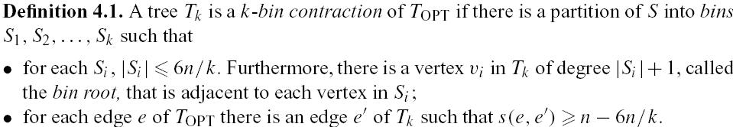
K-bin Tree

Slide 7
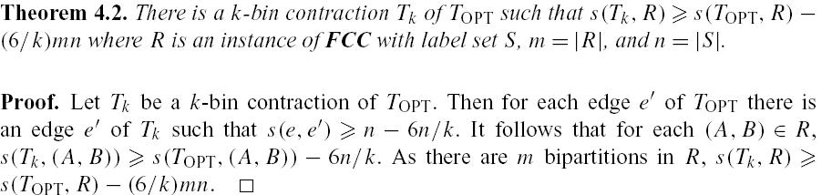
About K-bin Tree
We can use it to approximate FCC if we can find the K-bin tree T_{k} of T_{OPT} in FCC.
Since we don’t know the answer of FCC in advance, we can’t obtain T_{k} by direct transform from T_{OPT}. We have to find this T_{k} in another way. In this paper, the authors find T_{k} by discussing every kernel in LBA problem.

Slide 8
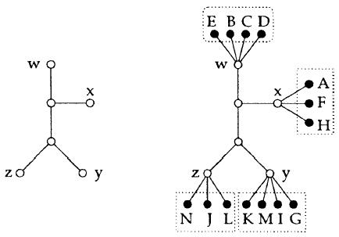

LBA Problem

Slide 9
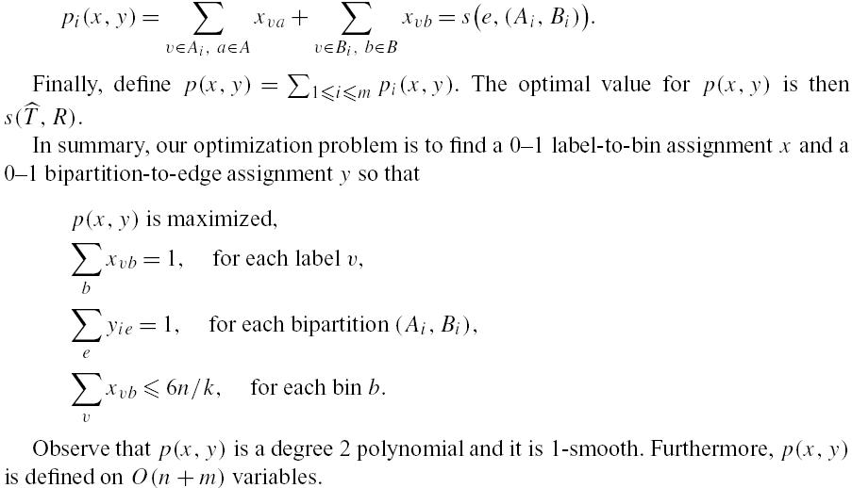
Solving LBA Using ILP (1/2)

Slide 10
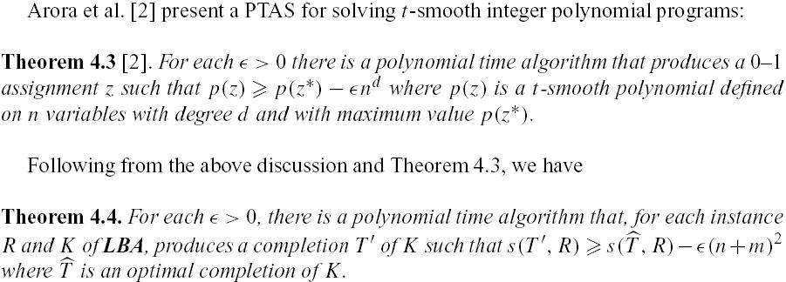
Solving LBA Using ILP (2/2)

Slide 11
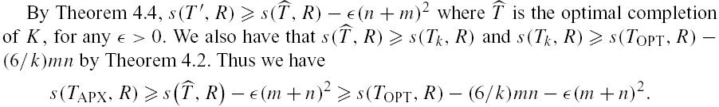
Approximation for FCC
Therefore, FCC is not MAX SNP-hard

Slide 12
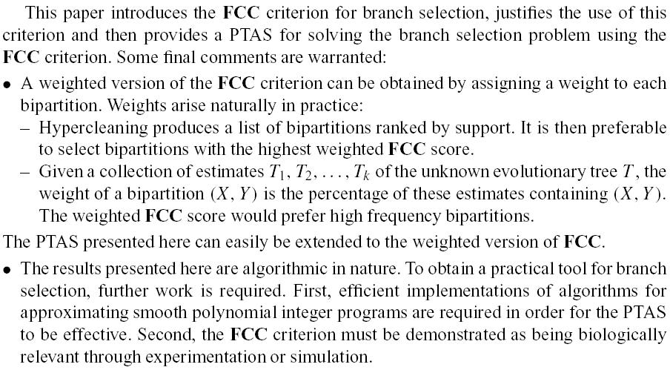
Conclusion

